Slide 1
LINN COUNTY PUBLIC HEALTH
COVID-19 Response for the Business Community
April 17, 2020

Slide 2
April 9, 2020
The Iowa Department of Public Health issued new guidance for the business community regarding outbreaks among employees.

Slide 3
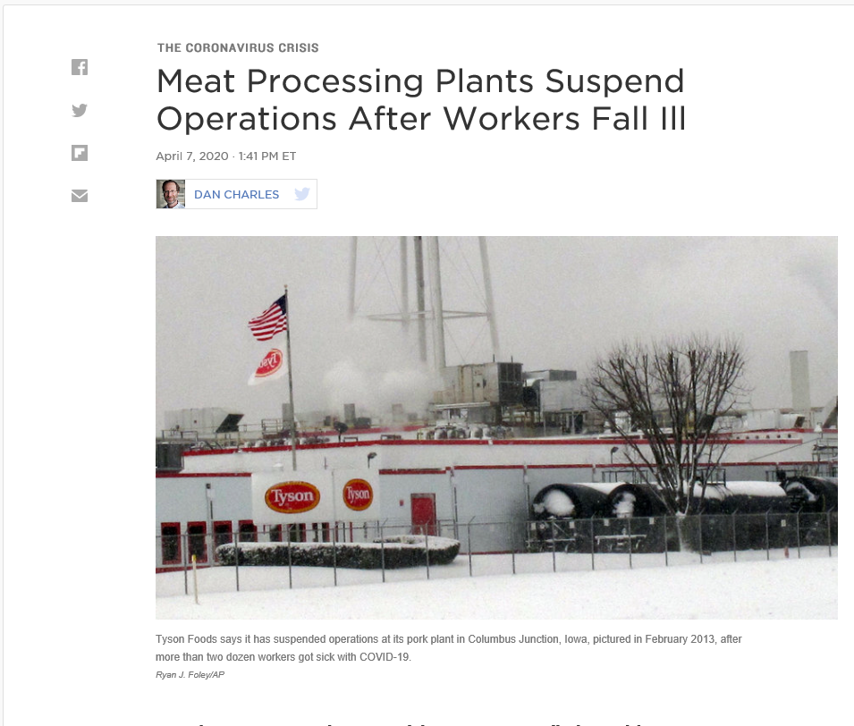
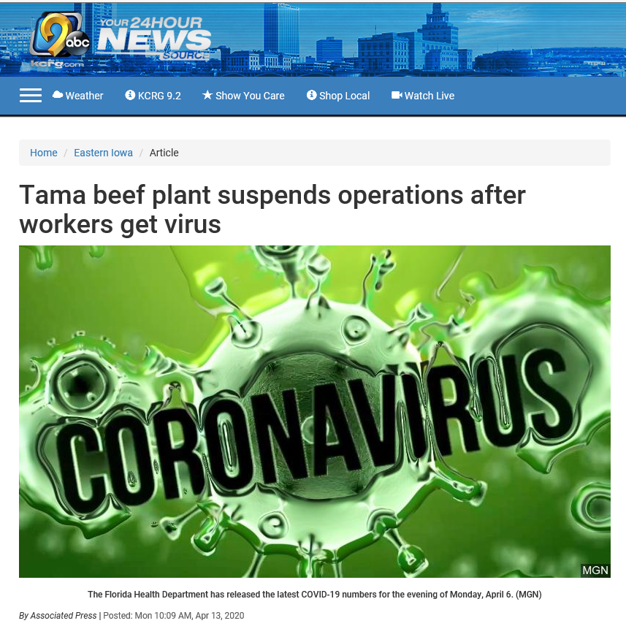
Why are we discussing this:
April 13, 2020 - KCRG
April 7, 2020 - NPR

Slide 4
Prevention:
Businesses should implement measures to enable social distancing as much as possible.
  Encourage flexible work-from-home and leave policies.
  Consider staggering shifts to reduce worker population at any given time.
  Stagger breaks to reduce staff interactions.
  Review procedures to identify ways to increase the physical separation of staff.

Slide 5
Prevention:
Businesses should prioritize hand hygiene and respiratory etiquette among employees.
  Businesses should provide or allow employees to wear their own homemade cloth facemasks.
  Businesses should provide hand sanitizer or handwashing opportunities as frequently as possible.
Communicate with all staff the importance of staying home, no matter how mild the illness.

Slide 6
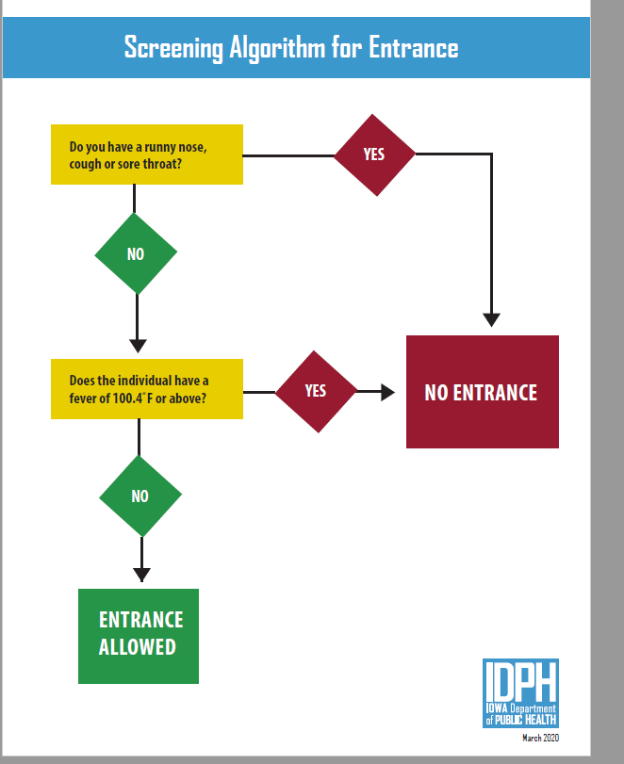
Prevention:
Screen all employees prior to entry.
Any employee that demonstrates symptoms of illness should remain home until:
  3 days free of fever without the use of medication AND
  Symptom improvement AND
  7 days from on-set of symptoms

Slide 7
Prevention:
Businesses should consider excluding high-risk employees when outbreaks are ongoing. High-risk employees would include:
  People aged 65 years and older
  People of all ages with underlying medical conditions, particularly if not well controlled, including:
    People with chronic lung disease or moderate to severe asthma
    People who have serious heart conditions
    People who are immunocompromised
  People with severe obesity (body mass index [BMI] ≥40)
  People with diabetes
  People with chronic kidney disease undergoing dialysis
  People with liver disease
  Pregnant women

Slide 8
Prevention:
Screen all employees by taking their temperature and assessing for cough, sore throat, difficulty breathing or any other respiratory symptom at the beginning and end of each shift.

Slide 9
Prevention:
Exclusion criteria must be followed with all symptomatic employees, regardless of whether the testing is completed (even if the employee tests negative for COVID-19 infection).
Please report to the Iowa Department of Public Health when 10% or greater of your employees are reporting COVID-19 symptoms (including fever, cough, sore throat, difficulty breathing, or any other respiratory symptom).
Report to public health by filling out the survey at this link: https://redcap.idph.state.ia.us/surveys/?s=NRJ4FDMDPN

Slide 10
Prevention:
Exclude all employees reporting fever or respiratory symptoms (these cases will be directed to stay home and isolate themselves from other people and animals in the home) until they:
  Have had no fever for at least 72 hours (that is three full days of no fever without the use of medicine that reduces fevers) AND
  Other symptoms have improved (for example, when your cough or shortness of breath have improved) AND
  At least 7 days have passed since your symptoms first appeared.

Slide 11
Prevention:
Linn County Public Health does not want our county business leaders to wait for 10% or greater of your employees to become ill.
  Call us if you are seeing trends.
  If we have a case of COVID-19 in a Linn County resident, we talk to the resident and obtain permission to contact employers.

Slide 12
Manage the Outbreak:
Coordinate with your occupational health provider to define a pathway to test symptomatic employees.
  Public health will approve State Hygienic Laboratory testing for symptomatic employees during outbreaks.
  The occupational health provider or employees’ personal health providers will be responsible for collecting the nasopharyngeal swab for testing and following-up for medical care as needed.

Slide 13
Managing the Outbreak
When employees test positive for COVID-19 infection, public health and occupational health will work jointly to investigate cases and identify the following contacts:
  household contacts,
  rideshare partners, and
  co-workers with prolonged contact (within 6 feet of the case for at least 30 minutes).
All of these contacts will be directed to stay at home and isolate themselves from other people and animals in the home for 14 days after the last known exposure to a person with COVID-19.

Slide 14
Managing the Outbreak:
Business decisions to close, should be based upon workforce availability and the ability to follow the recommended measures outlined in previous slides.
Linn County Public Health does not close an Iowa Business due to infectious disease, we only provide guidance.

Slide 15
Managing the Outbreak:
Information regarding the cleaning and disinfection for community facilities can be found at: https://www.cdc.gov/coronavirus/2019-ncov/community/organizations/cleaning-disinfection.html
List of approved cleaners can be found at: https://www.epa.gov/pesticide-registration/list-n-disinfectants-use-against-sars-cov-2

Slide 16
Questions:
Can an occupational health clinic perform testing now?
  Yes, but you are responsible for your PPE (personal protective equipment) and for obtaining the test kits.

Slide 17
Questions:
Can occupational health clinics send the samples into SHL for analysis?
  Yes. However, you must use the IDPH guidelines for testing.
  All hospitalized patients (of any age) with fever and respiratory illness
  Older adults (>60 years of age) with fever and respiratory symptoms (cough, difficulty breathing) and chronic medical conditions (e.g., diabetes, heart disease, immunosuppressive medications, chronic lung disease, or chronic kidney disease).
  Persons of any age with fever or respiratory illness who live in congregate setting (i.e., long term care facilities, dormitories, residential facilities, correctional facilities, treatment facilities)
  Healthcare workers, essential services personnel, first responders and critical infrastructure workers with fever or respiratory illness (ex. healthcare workers, fire and EMS, law enforcement, residential facility staff)
COVID-19 Testing Hotline:(855) 374-4692

Slide 18
Questions:
If our staff do not qualify for testing with SHL, can we do anything else?
  Yes, you can send test samples to a reference lab for testing.
    We do not recommend mass testing for employees:
      Although there are more test kits available, if wide spread testing starts, those will quickly become depleted.
      This will put a strain on the PPE supply
      Due to community spread, individuals that are negative today, may be positive in the next few days.
      It is not recommended to test employees prior to return to work

Slide 19
Questions:
What do I do if our company does not have an occupational health clinic?
  Contact an occupational health clinic to set-up an account.
  Employees may also see their private healthcare provider.
    Always call the provider before sending a person for testing!

Slide 20

Questions???

Slide 21
Heather Meador RN, BSN
Linn County Public Health Clinical Branch Supervisor
Heather.meador@linncounty.org
319-892-6061

